Slide 1
National STAR and State CRE Events for 2015-2016
California State Events:
Apparel Construction
Child Development
Culinary Display
Interior Design
Menu Planning and Table Display
Salad Preparation
Notes:
Presentation for student members. Needs pictures of events; use your students when possible

Slide 2
FCCLA Planning Process

Slide 3
STAR Events Project Summary Form http://fcclainc.org/programs/resources.php

Slide 4
STAR Events Project Summary Form http://fcclainc.org/programs/resources.php
2. How many members are competing on this team?
3. Participant Information: Name, Chapter ID #, School, City, State, Zip
4. Competition Category: Junior, Senior, Occupational
5. What is the title of your project? (Do not enter the title of your event)
6. Provide a brief overview of your project (one paragraph)
7. Was your project part of one of the national FCCLA programs?
8. If yes to question 7, which program did you use? (Career Connection, FACTS, Families
First, Japanese Exchange, Financial Fitness, Leadership Service in Action, Power of One,
STOP the Violence-Students Taking on Prevention, or Student Body)
9. How many people have you reached through this project? (Research, Presentations, PR)
10. How did this project positively impact your family, school, or community?
11. During the 2015–16 school year, are you or any members of your team enrolled in at
least one HECT/FCS course?
12. Participation in FCCLA has helped me learn or improve the following skills, check all that
apply: (Awareness of Community, Communication, Creativity, Leadership, Teamwork, etc.)
13. Why did you choose to compete in this STAR Event? (Advisor, Friends, Classwork, etc.)
14. Rate how useful your STAR Events experience will be in your future.
15. Are you planning on pursuing higher education/career related to this event?
* Students will Click Submit and will include proof of submission in their portfolio.

Slide 5
STAR Events Project Summary Form http://fcclainc.org/programs/resources.php

Slide 6
California State CRE Events
EVENT CATEGORIES
JUNIOR: GRADE 6TH – 9TH
SENIOR: GRADES 10TH -12TH
OCCUPATIONAL: 10TH -12TH

Slide 7
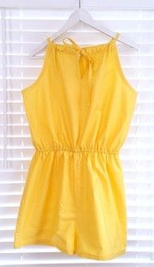
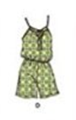
Apparel Construction
Apply apparel construction skills.
Construct a project from the specified pattern in 90 minutes and develop a Fabric Profile and Cost Itemization.
At the state level only, participants will take a 20 minute written exam.
Note: Garment in State Fashion Show
Only Senior Level 1st and 2nd state winners qualify for NLC in STAR Fashion Construction
Required 2015-16 Theme:
Junior: Simplicity 1140 “Apron” View C
Senior: Simplicity 1355 “Short Jumpsuit” View D
Notes:
An individual event- recognizes participants to demonstrate construction techniques, effective management skills, and knowledge of the consumer aspects of clothing selection, design, and care utilizing state patterns. (J, S, + for S only)

Slide 8
Apparel Construction
Notes:
An individual event- recognizes participants to demonstrate construction techniques, effective management skills, and knowledge of the consumer aspects of clothing selection, design, and care utilizing state patterns. (J, S, + for S only)

Slide 9
Apparel Construction
Notes:
An individual event- recognizes participants to demonstrate construction techniques, effective management skills, and knowledge of the consumer aspects of clothing selection, design, and care utilizing state patterns. (J, S, + for S only)

Slide 10
Apparel Construction
Notes:
An individual event- recognizes participants to demonstrate construction techniques, effective management skills, and knowledge of the consumer aspects of clothing selection, design, and care utilizing state patterns. (J, S, + for S only)

Slide 11
Apparel Construction
Notes:
An individual event- recognizes participants to demonstrate construction techniques, effective management skills, and knowledge of the consumer aspects of clothing selection, design, and care utilizing state patterns. (J, S, + for S only)

Slide 12
Apparel Construction
Notes:
An individual event- recognizes participants to demonstrate construction techniques, effective management skills, and knowledge of the consumer aspects of clothing selection, design, and care utilizing state patterns. (J, S, + for S only)

Slide 13
Apparel Construction
Notes:
An individual event- recognizes participants to demonstrate construction techniques, effective management skills, and knowledge of the consumer aspects of clothing selection, design, and care utilizing state patterns. (J, S, + for S only)

Slide 14
Apparel Construction
Notes:
An individual event- recognizes participants to demonstrate construction techniques, effective management skills, and knowledge of the consumer aspects of clothing selection, design, and care utilizing state patterns. (J, S, + for S only)

Slide 15
Child Development
Develop and refine child development skills.
Demonstrate their ability to select and present a song, story, or educational activity for preschool children.

Slide 16
Child Development

Slide 17
Child Development

Slide 18
Child Development

Slide 19
Child Development

Slide 20
Child Development

Slide 21
Child Development

Slide 22
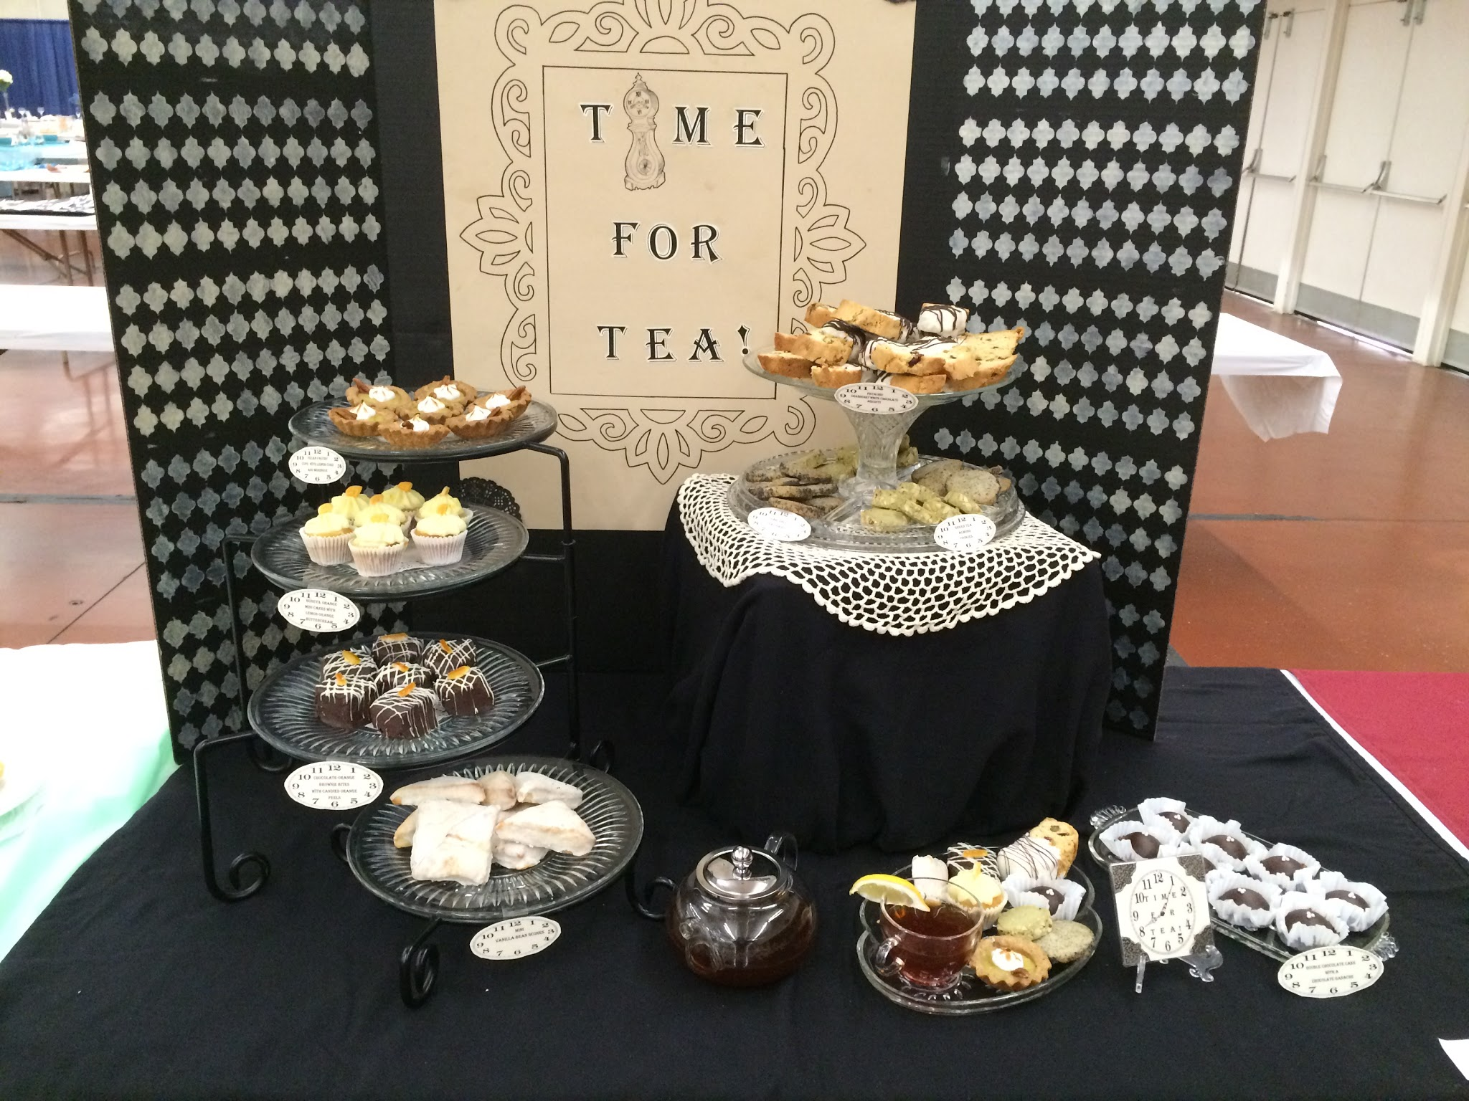
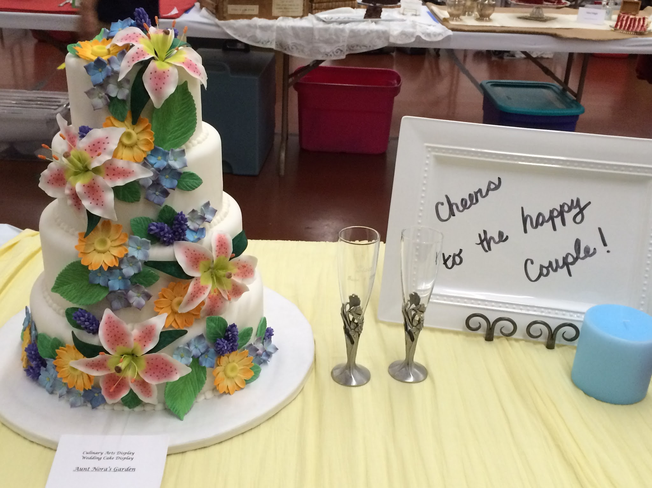
Culinary Display (Previously titled Culinary Arts)
Demonstrate skill in presenting foods for a buffet table and for fine restaurant dining.
Only Occupational: 10th -12th
For participants enrolled in occupational culinary arts and/or food service training programs.

Slide 23
Culinary Display (Previously titled Culinary Arts)

Slide 24
Culinary Display (Previously titled Culinary Arts)

Slide 25
Culinary Display (Previously titled Culinary Arts)

Slide 26
Culinary Display (Previously titled Culinary Arts)

Slide 27
Interior Design
Create a floor plan, an elevation and a furniture/interior plan addressing the specifics of the design theme.
Prepare a file folder, an oral presentation, and presentation board.
Only Senior Level 1st/2nd state winners quality for NLC in STAR Interior Design
Required 2015-16 Themes:
Junior: “Art/Craft Room” 12’x12’
Senior: “Go Green” 36’x28’ (Includes Living Room and Dining Room)
Notes:
Junior: “Art/Craft Room” 12’x12’
Senior“Go Green” 36’x28’ (Includes Living Room and Dining Room)

Slide 28
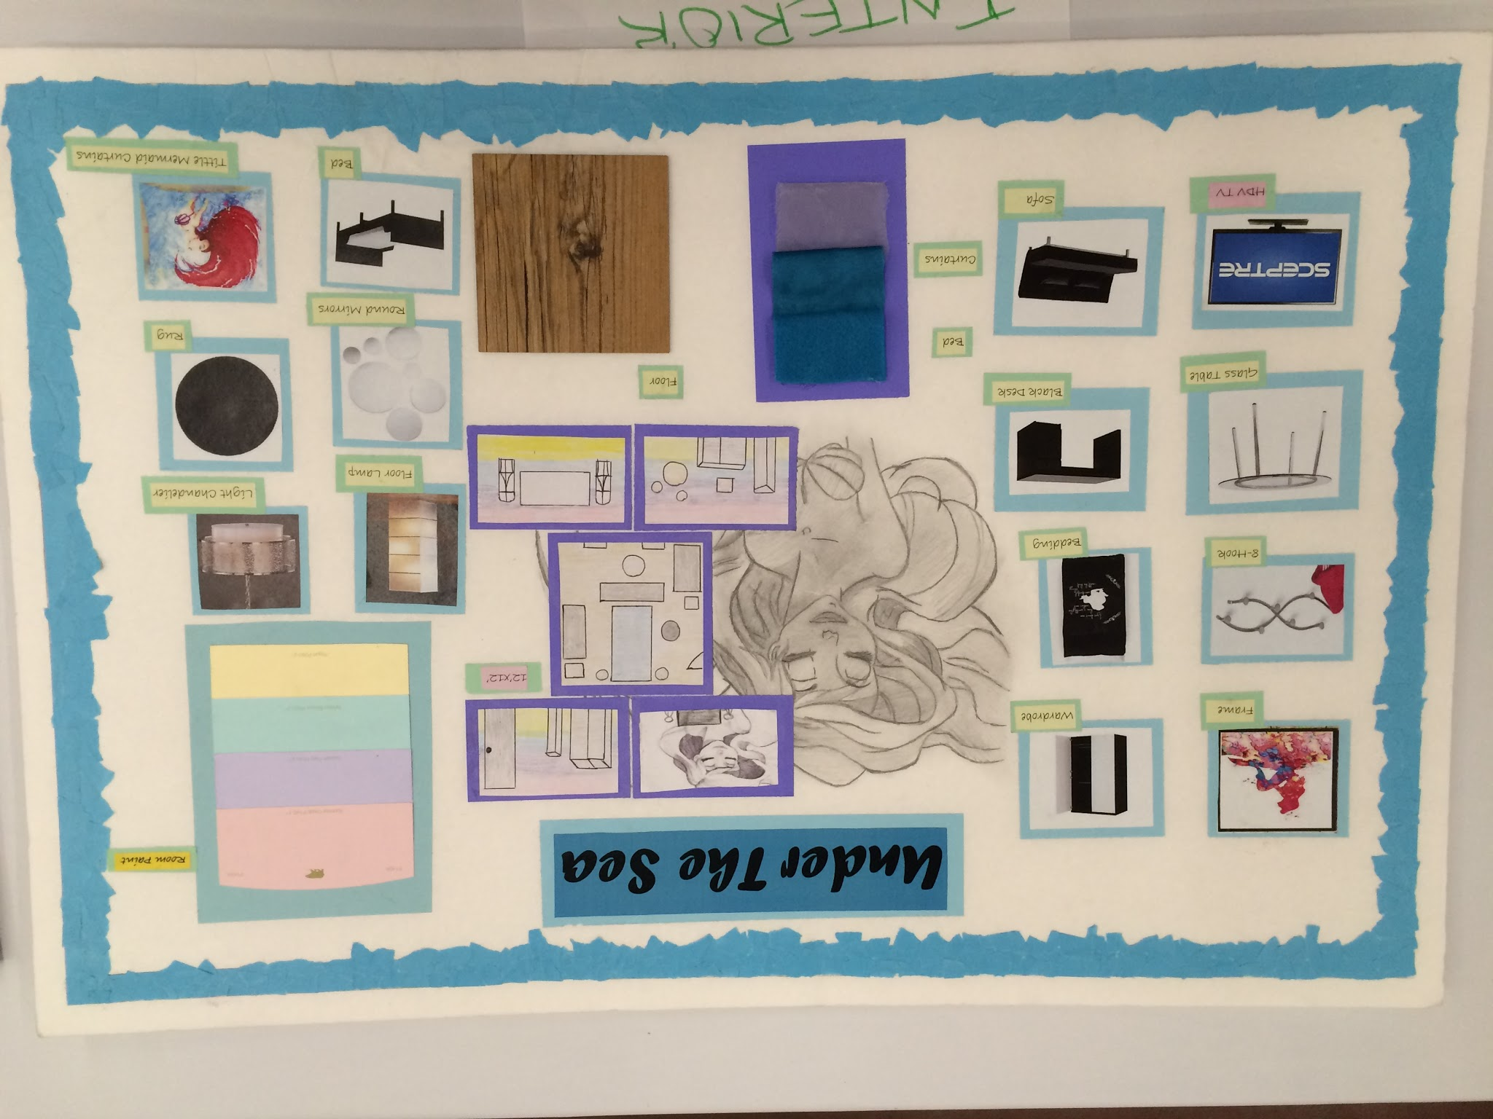
Interior Design
Notes:
Junior: “Art/Craft Room” 12’x12’
Senior“Go Green” 36’x28’ (Includes Living Room and Dining Room)

Slide 29
Interior Design
Notes:
Junior: “Art/Craft Room” 12’x12’
Senior“Go Green” 36’x28’ (Includes Living Room and Dining Room)

Slide 30
Interior Design
Notes:
Junior: “Art/Craft Room” 12’x12’
Senior“Go Green” 36’x28’ (Includes Living Room and Dining Room)

Slide 31
Interior Design
Notes:
Junior: “Art/Craft Room” 12’x12’
Senior“Go Green” 36’x28’ (Includes Living Room and Dining Room)

Slide 32
Interior Design
Notes:
Junior: “Art/Craft Room” 12’x12’
Senior“Go Green” 36’x28’ (Includes Living Room and Dining Room)

Slide 33
Interior Design
Notes:
Junior: “Art/Craft Room” 12’x12’
Senior“Go Green” 36’x28’ (Includes Living Room and Dining Room)

Slide 34
Interior Design
Notes:
Junior: “Art/Craft Room” 12’x12’
Senior“Go Green” 36’x28’ (Includes Living Room and Dining Room)

Slide 35
Interior Design
Notes:
Junior: “Art/Craft Room” 12’x12’
Senior“Go Green” 36’x28’ (Includes Living Room and Dining Room)

Slide 36
Menu Planning and Table Display
Demonstrate skill in menu planning.
Plan a lunch or dinner menu for 2 people based on state theme.
Bring all materials for a creative table display.
Prepare a menu with recipes and nutritional analysis.
Required 2015-2016 Theme:
Junior: “All Things Seuss” Lunch with Friends
Senior: “Great Gatsby” Dinner Party

Slide 37
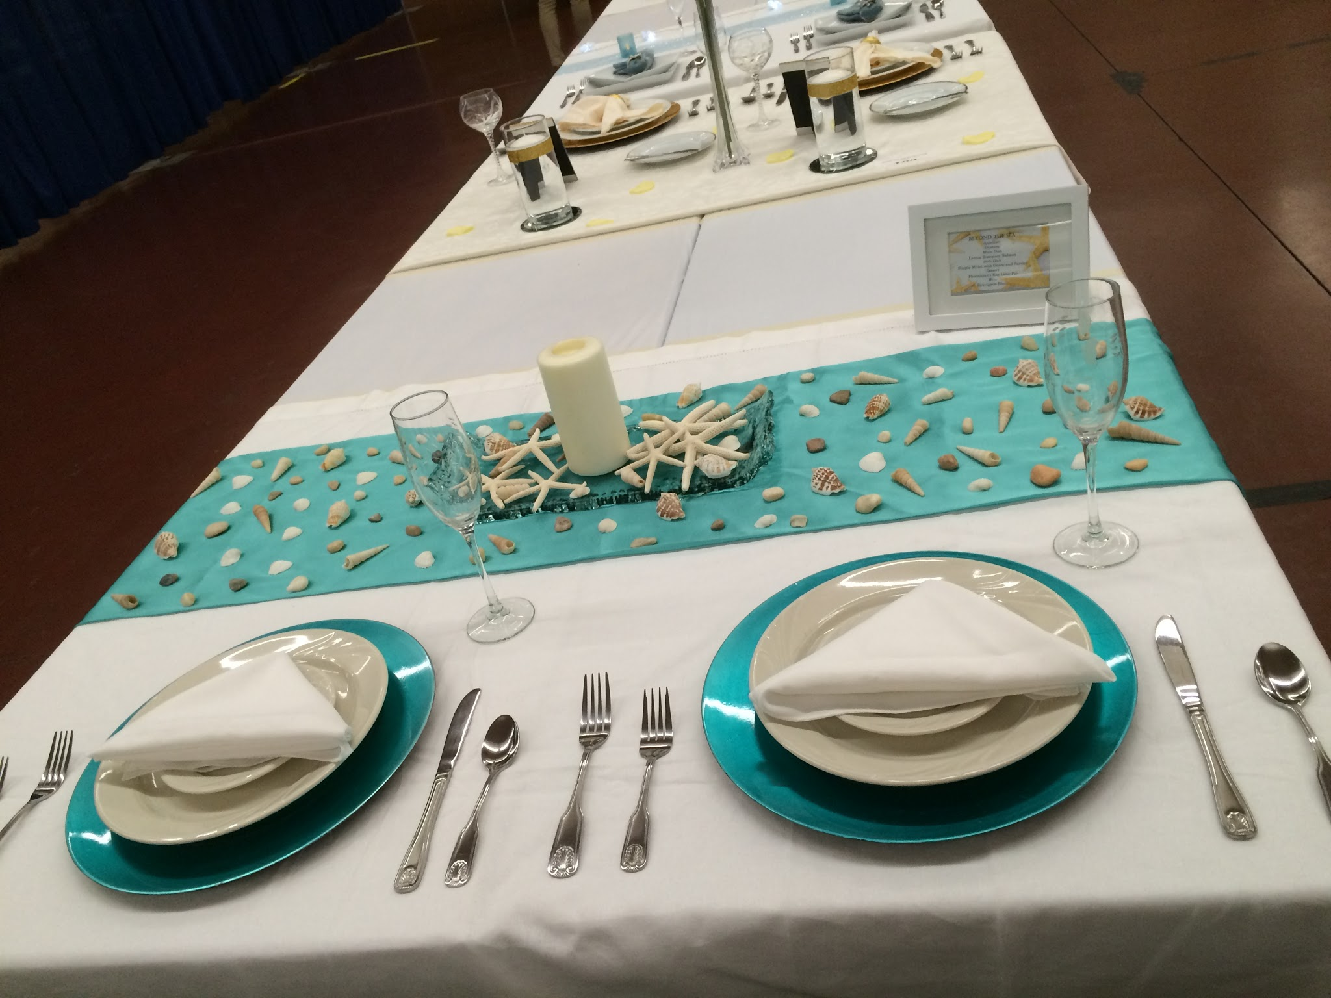
Menu Planning and Table Display

Slide 38
Menu Planning and Table Display

Slide 39
Menu Planning and Table Display

Slide 40
Menu Planning and Table Display

Slide 41
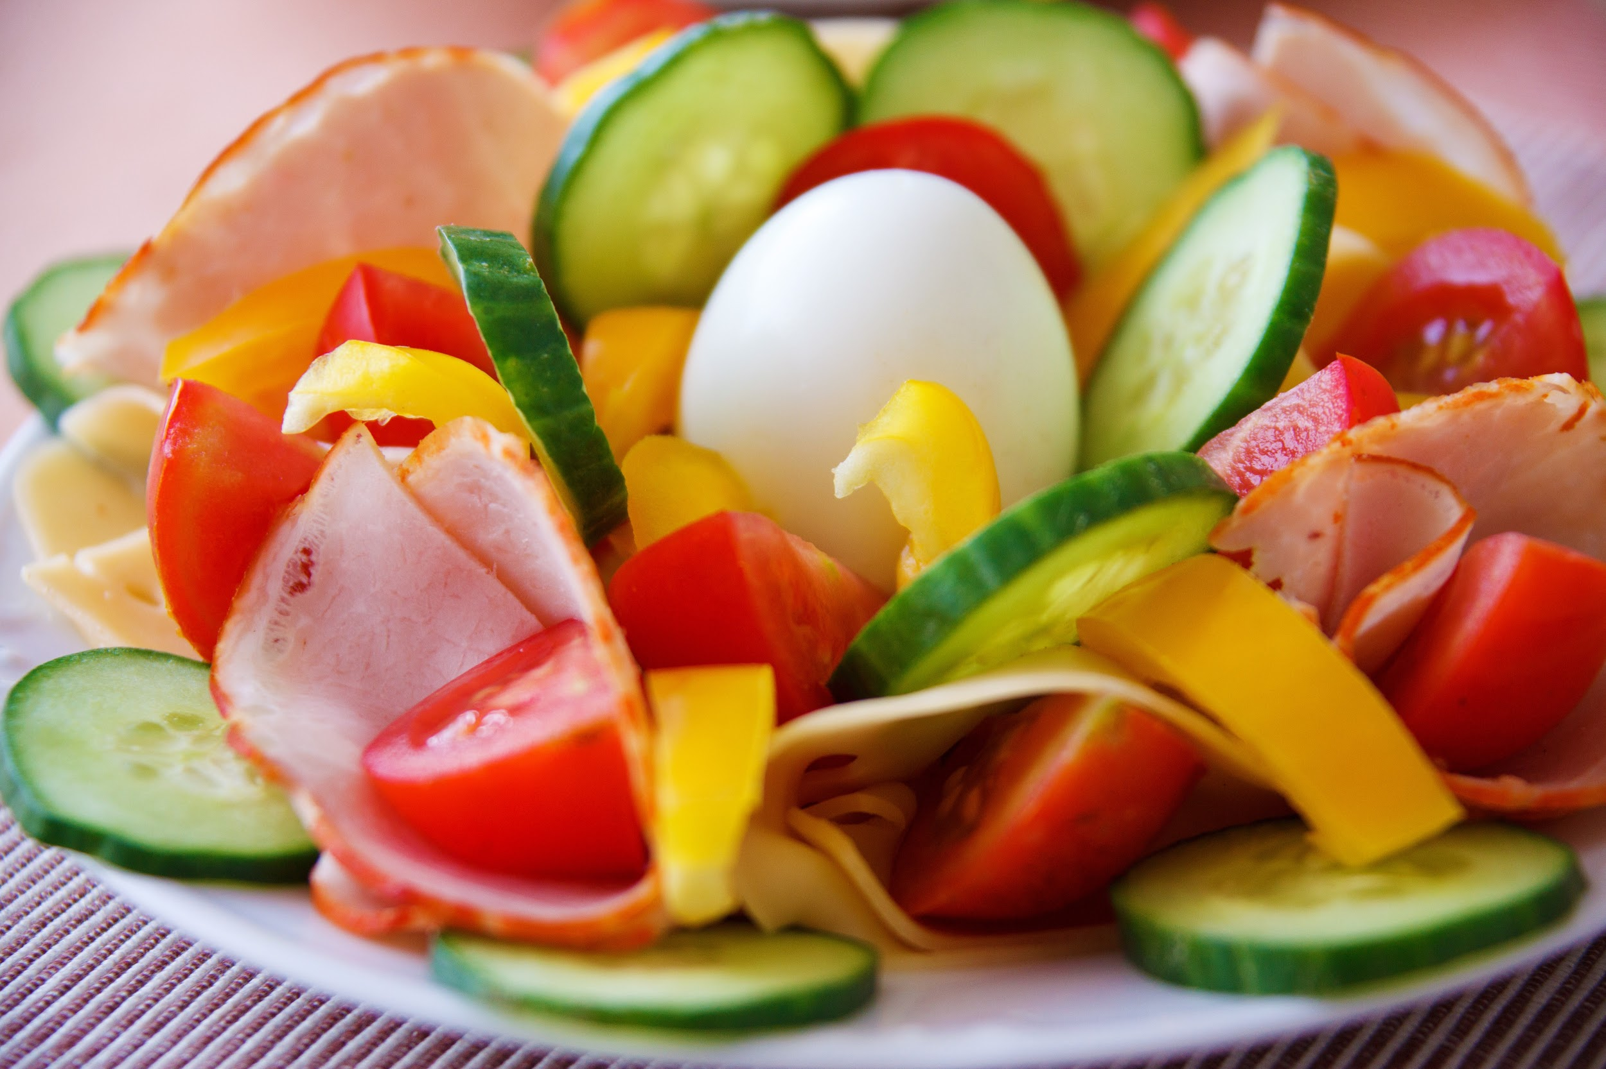
Salad Preparation
Demonstrate competencies in preparing salads for home use.
Prepare a salad and salad dressing according to the state theme.
Bring recipes and all ingredients, equipment and tools to make the salad and dressing.
At the state level only, participants will take a 20 minute written examination.
Required 2015-2016 Theme:
Junior: A salad containing a fruit. No tofu, beef, poultry, pork, fish, seafood, or eggs.
Senior: A salad that contains a cooked grain. No tofu, beef, poultry, pork, fish, seafood, or eggs.
Notes:
4. At the state level only, participants will take a twenty (20) minute written objective examination. The exam will be given prior to the performance portion of
this event. The exam will include, but will not be limited to: questions on nutrition; tools and equipment identification, including usage; food preparation skills and terms related to salads and uncooked salad dressings; safety, sanitation; and meal management.

Slide 42
Salad Preparation
Notes:
4. At the state level only, participants will take a twenty (20) minute written objective examination. The exam will be given prior to the performance portion of
this event. The exam will include, but will not be limited to: questions on nutrition; tools and equipment identification, including usage; food preparation skills and terms related to salads and uncooked salad dressings; safety, sanitation; and meal management.

Slide 43
Salad Preparation
Notes:
4. At the state level only, participants will take a twenty (20) minute written objective examination. The exam will be given prior to the performance portion of
this event. The exam will include, but will not be limited to: questions on nutrition; tools and equipment identification, including usage; food preparation skills and terms related to salads and uncooked salad dressings; safety, sanitation; and meal management.

Slide 44
Salad Preparation
Notes:
4. At the state level only, participants will take a twenty (20) minute written objective examination. The exam will be given prior to the performance portion of
this event. The exam will include, but will not be limited to: questions on nutrition; tools and equipment identification, including usage; food preparation skills and terms related to salads and uncooked salad dressings; safety, sanitation; and meal management.

Slide 45
Student Activity: Which STAR/CRE is right for You?
Region
Update/
State
Region
Update/
State
State
Only

Slide 46
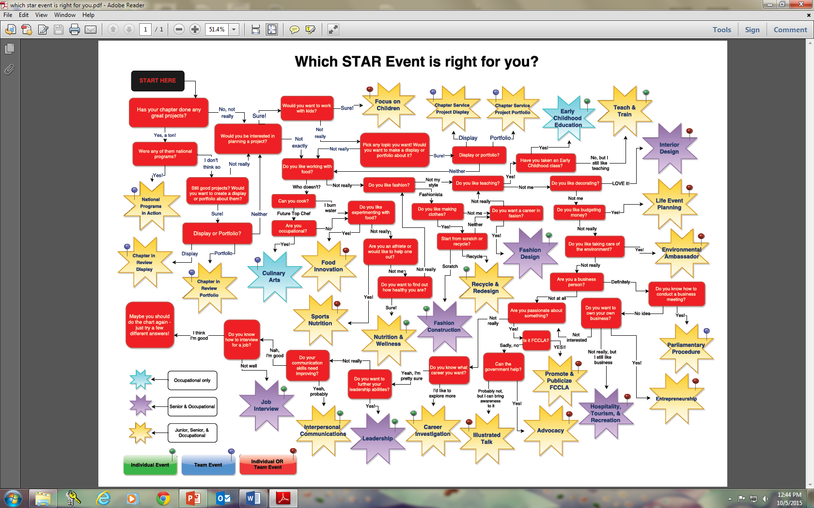
Student Activity: Which STAR Event/CRE is right for You?

Slide 47
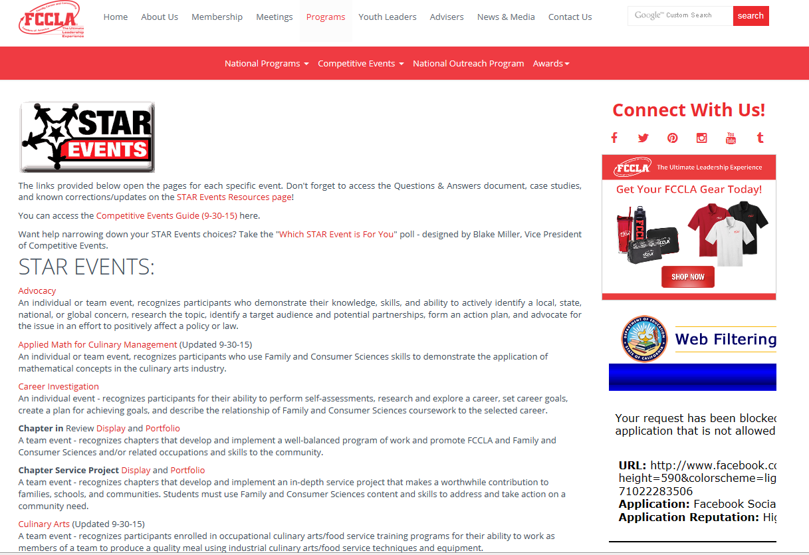
http://fcclainc.org/programs/star-event-descriptions.php

Slide 48
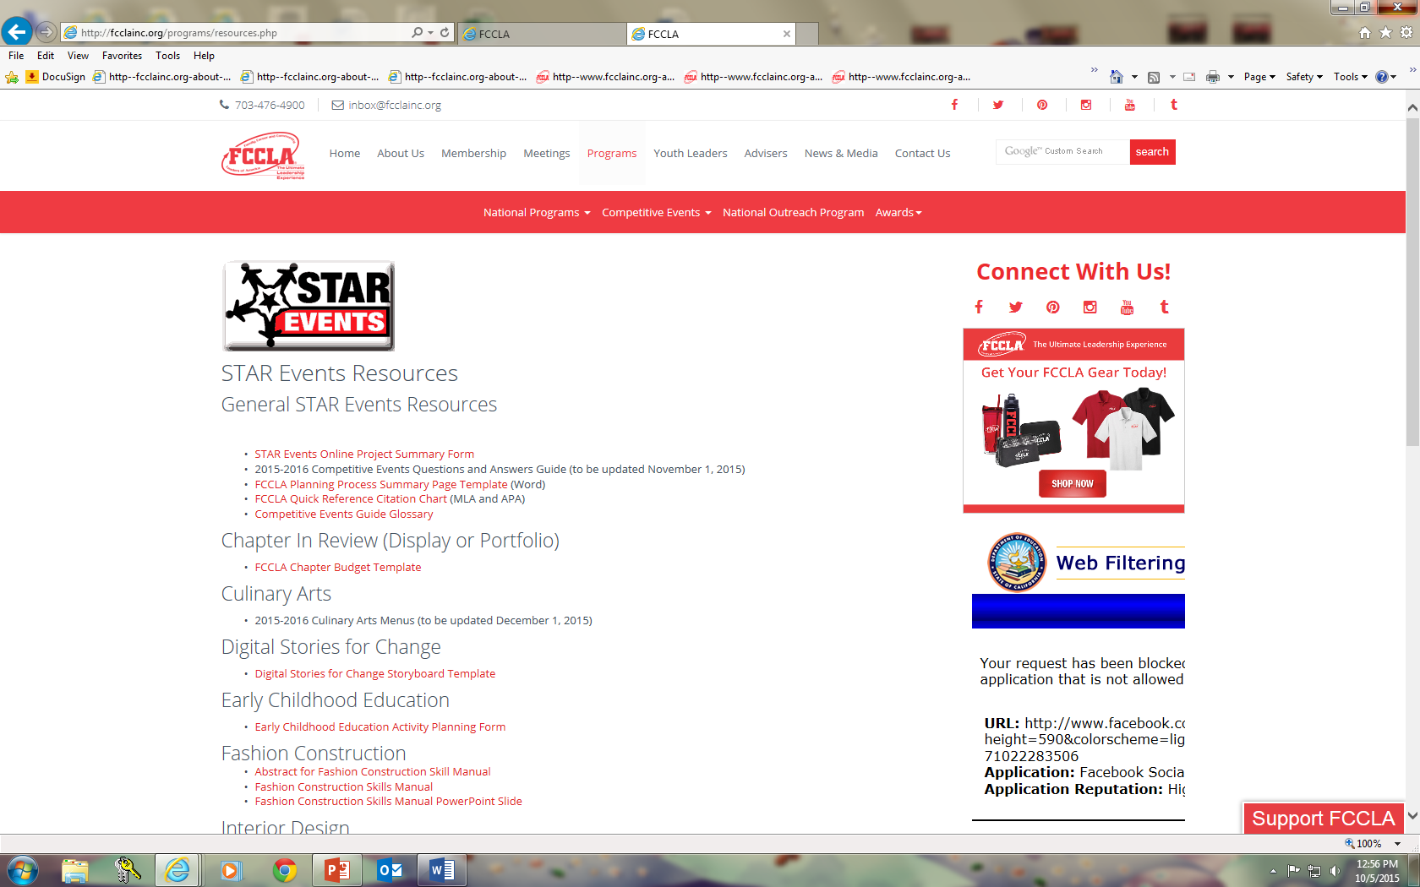
http://fcclainc.org/programs/resources.php

Slide 49
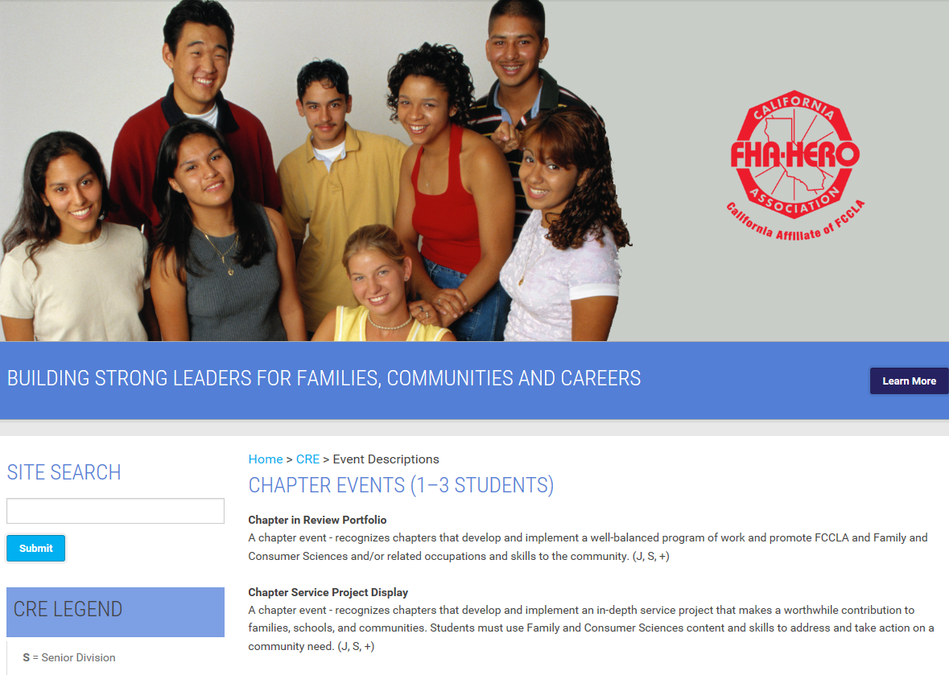
http://ca-fhahero-fccla.org/

Slide 50
http://ca-fhahero-fccla.org/

Slide 51
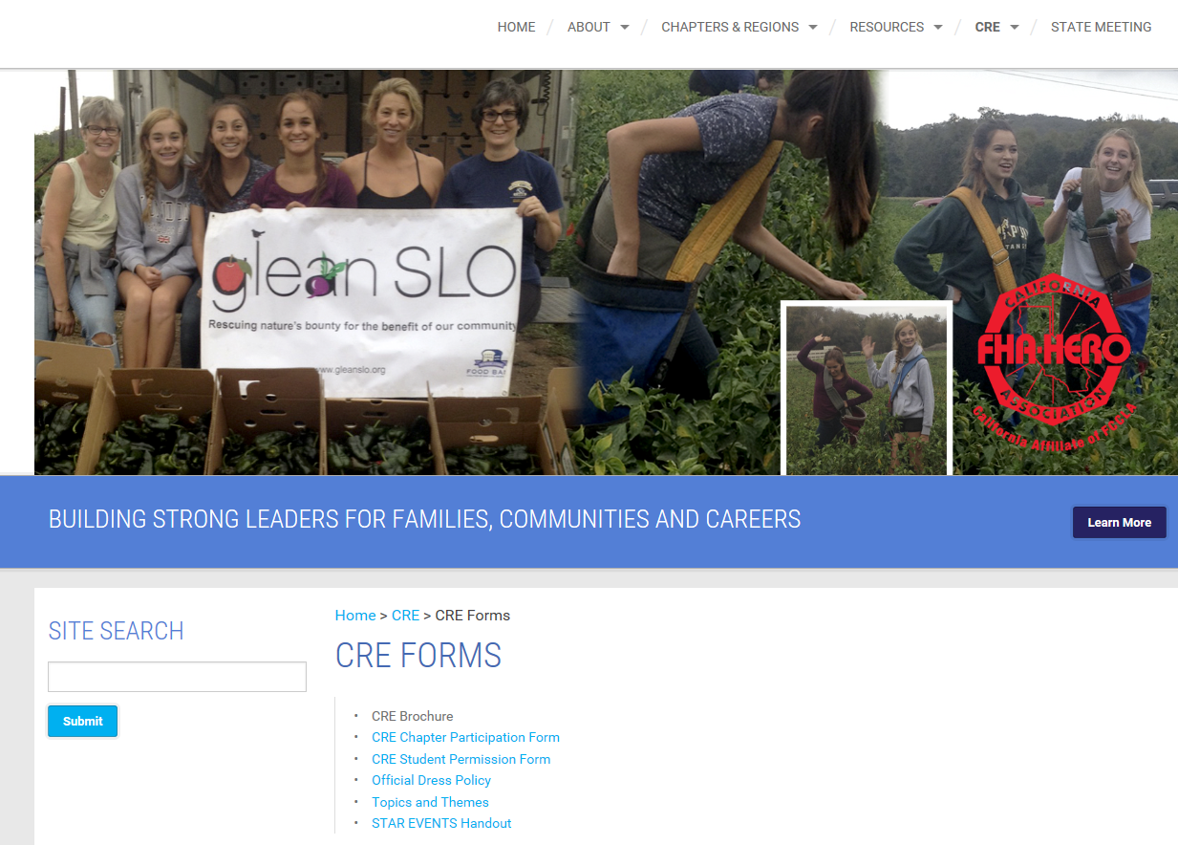
http://ca-fhahero-fccla.org/

Slide 52
Questions: Please type questions in chat box.
Thank you for your participation in today’s webinar.

